Slide 1
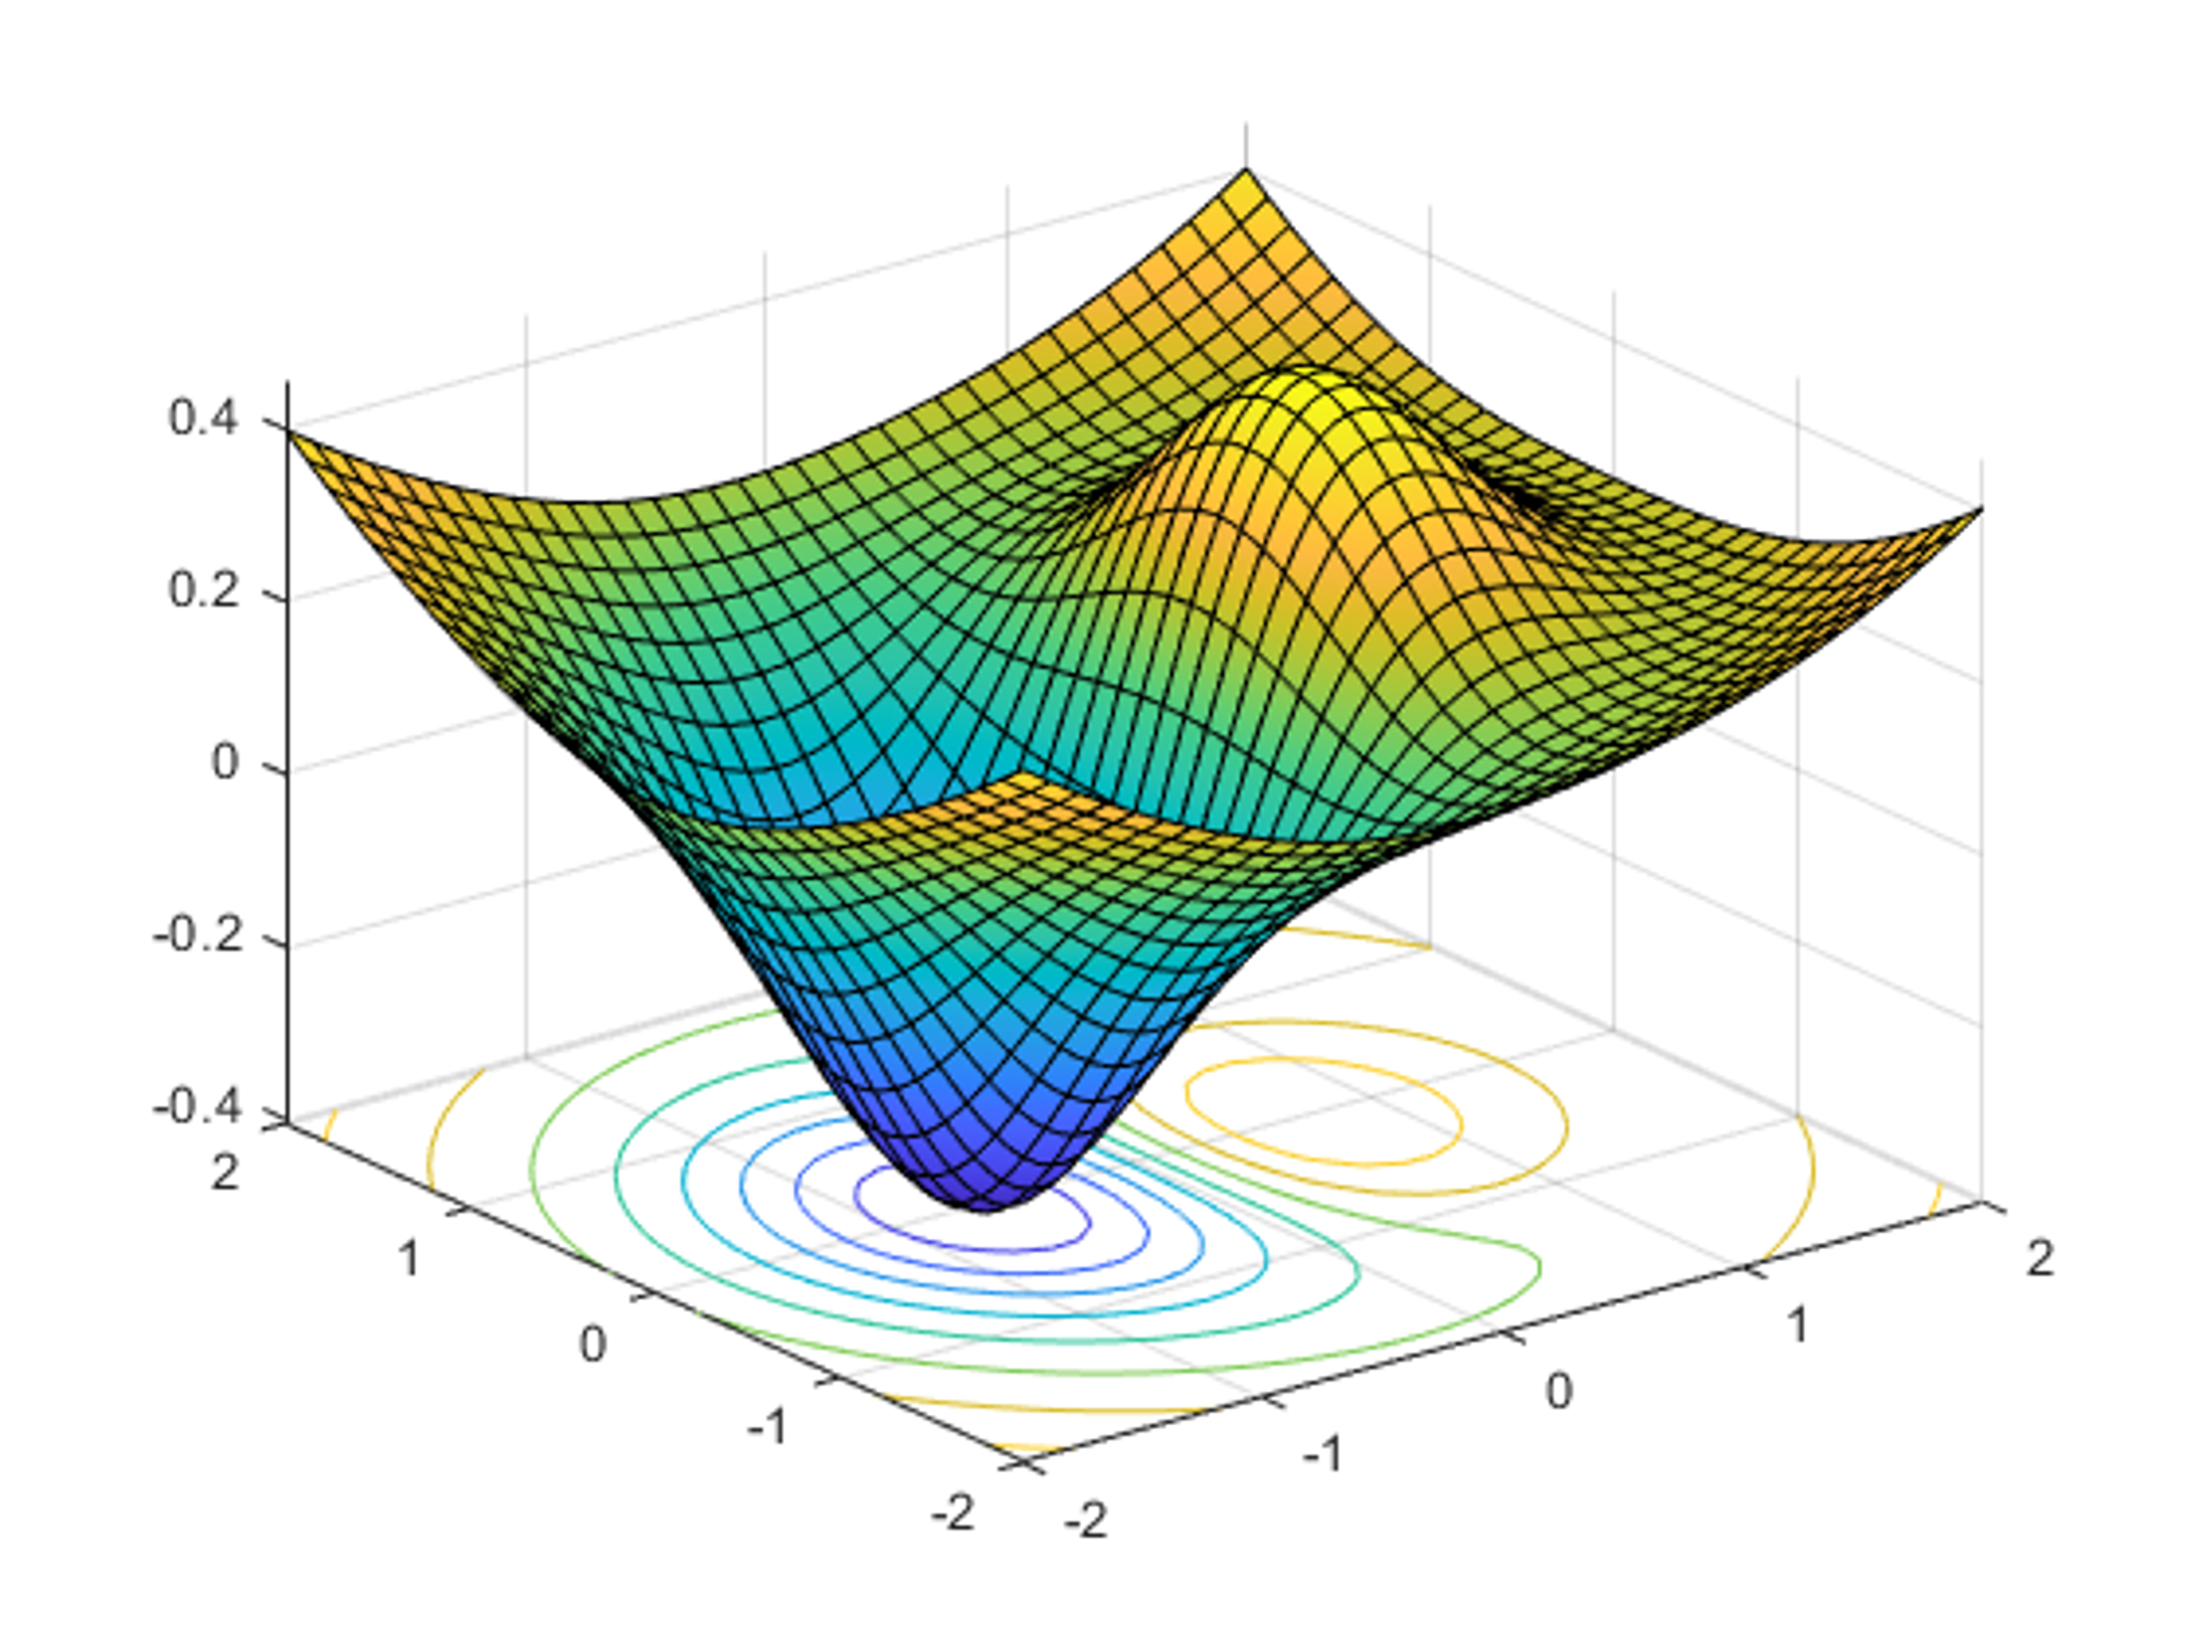

DATA 585 Optimization
Picture generated on MATLAB using
f = @(x,y) x.*exp(-x.^2-y.^2)+(x.^2+y.^2)/20;
fsurf(f,[-2,2],'ShowContours','on’)
Code example from https://www.mathworks.com/help/optim/ug/optimization-toolbox-tutorial.html
Instructor: Yves Lucet
$$\min{\{f\left(x\right):g\left(x\right)≤0;h\left(x\right)=0;x∈S\}}$$
We respectfully acknowledge the Syilx Okanagan Nation and their peoples, in whose traditional, ancestral, unceded territory UBC Okanagan is situated.

Slide 2
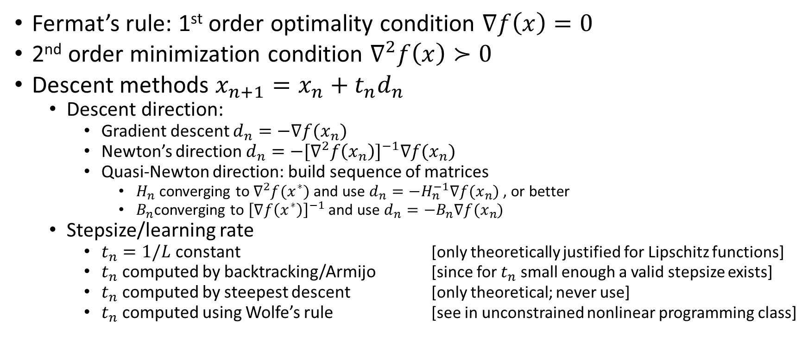

Summary $\min_{x}{f(x)}$
Fermat’s rule: 1st order optimality condition $∇f\left(x\right)=0$
2nd order minimization condition $∇^{2}f\left(x\right)≻0$
Descent methods $x_{n+1}=x_{n}+t_{n}d_{n}$
Descent direction:
Gradient descent $d_{n}=−∇f(x_{n})$
Newton’s direction $d_{n}=−{[∇}^{2}f{\left(x_{n}\right)]}^{−1}∇f(x_{n})$
Quasi-Newton direction: build sequence of matrices
$H_{n}$ converging to $∇^{2}f(x^{∗})$ and use $d_{n}=−H_{n}^{−1}∇f(x_{n})$, or better
$B_{n}$converging to ${\left[∇f\left(x^{∗}\right)\right]}^{−1}$and use $d_{n}=−B_{n}∇f(x_{n})$
Stepsize/learning rate
$t_{n}=1/L$ constant [only theoretically justified for Lipschitz functions]
$t_{n}$ computed by backtracking/Armijo [since for $t_{n}$ small enough a valid stepsize exists]
$t_{n}$ computed by steepest descent [only theoretical; never use]
$t_{n}$ computed using Wolfe’s rule [see in unconstrained nonlinear programming class]

Slide 3

Menu
Linear Programming
Modeling
Example
Simplex algorithm
Duality
Image courtesy of Gregory Szarkiewicz / FreeDigitalPhotos.net

Slide 4
Example
A factory produces frozen orange concentrate and a fresh orange drink. The inputs:
Fresh oranges
Water
Electricity
Profits and requirements:
1 unit of orange concentrate makes $2 profit, and requires 1 unit of fresh oranges and 2 units of electricity. A by-product is 1 unit of water.
1 unit of orange drink makes $3 profit, and requires 1 unit of fresh oranges, 1 unit of water and 1 unit of electricity.
Constraints: available are
10 units of electricity
6 units of oranges
4 units of water
Example borrowed from Dr. Heinz Bauschke who borrowed it from Waterloo optimizers

Slide 5
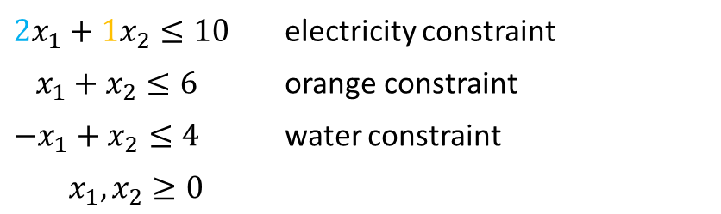
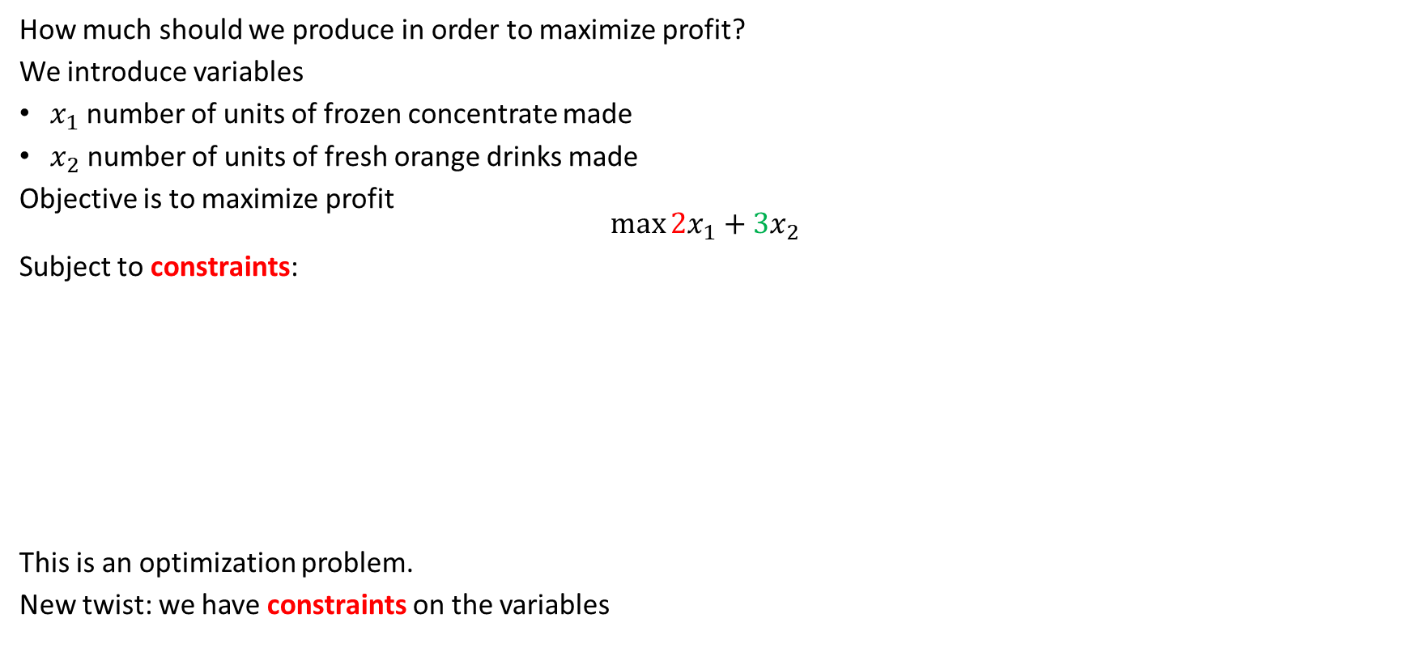
Optimizing with constraints
How much should we produce in order to maximize profit?
We introduce variables
$x_{1}$ number of units of frozen concentrate made
$x_{2}$ number of units of fresh orange drinks made
Objective is to maximize profit $$\max{2x_{1}+3x_{2}}$$
Subject to constraints:
This is an optimization problem.
New twist: we have constraints on the variables
$2x_{1}+1x_{2}≤10$ | electricity constraint
$x_{1}+x_{2}≤6$ | orange constraint
$−x_{1}+x_{2}≤4$ | water constraint
$$x_{1},x_{2}≥0$$
Constraints: available are
10 units of electricity
6 units of oranges
4 units of water
1 unit of orange concentrate makes $2 profit, and requires 1 unit of fresh oranges and 2 units of electricity. A by-product is 1 unit of water.
1 unit of orange drink makes $3 profit, and requires 1 unit of fresh oranges, 1 unit of water and 1 unit of electricity.

Slide 6
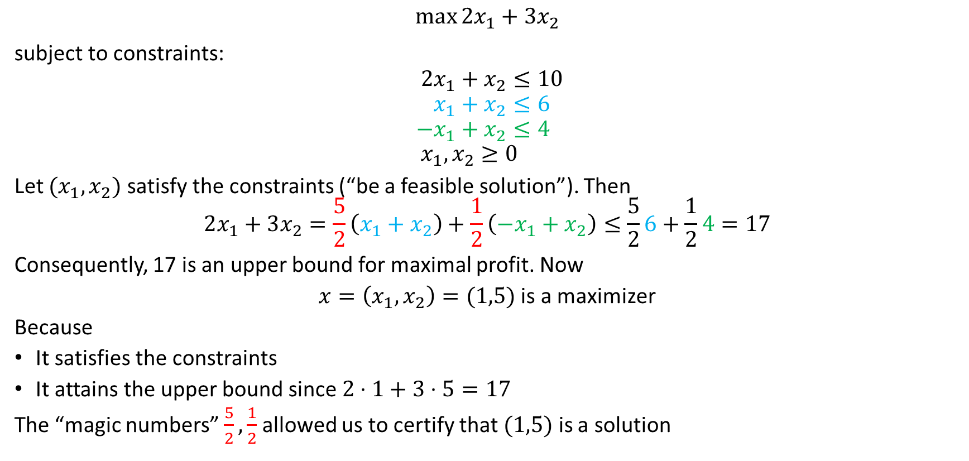
Optimal solution
$$\max{2x_{1}+3x_{2}}$$ subject to constraints: $$2x_{1}+x_{2}≤10 \\ x_{1}+x_{2}≤6 \\ −x_{1}+x_{2}≤4 \\ x_{1},x_{2}≥0$$
Let $(x_{1},x_{2})$ satisfy the constraints (“be a feasible solution”). Then
$$2x_{1}+3x_{2}=\frac{5}{2}\left(x_{1}+x_{2}\right)+\frac{1}{2}\left(−x_{1}+x_{2}\right)≤\frac{5}{2}6+\frac{1}{2}4=17$$
Consequently, 17 is an upper bound for maximal profit. Now
$x=\left(x_{1},x_{2}\right)=(1,5)$ is a maximizer
Because
It satisfies the constraints
It attains the upper bound since $2⋅1+3⋅5=17$
The “magic numbers” $\frac{5}{2},\frac{1}{2}$ allowed us to certify that $(1,5)$ is a solution

Slide 7

Finding a maximizer systematically
The solution $\left(x_{1},x_{2}\right)=(1,5)$ was pulled out of a hat like a rabbit!!
How do we find it systematically? Using the Simplex Method

Slide 8
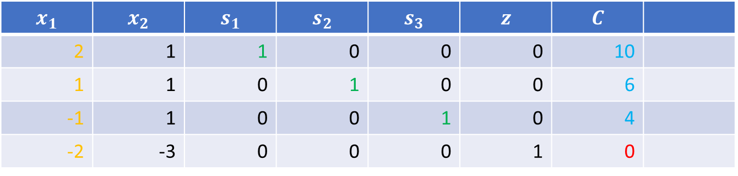
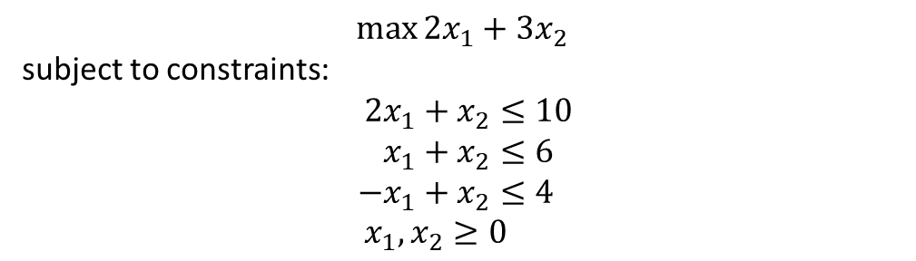
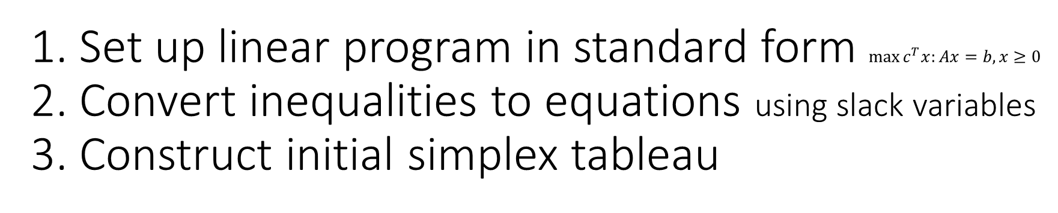
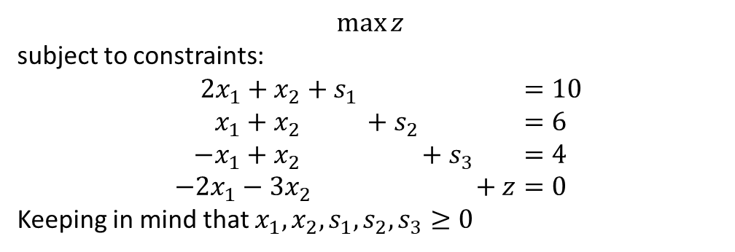
1. Set up linear program in standard form $\max{c^{T}x:Ax=b,x≥0}$ 2. Convert inequalities to equations using slack variables 3. Construct initial simplex tableau
$$\max{2x_{1}+3x_{2}}$$ subject to constraints: $$2x_{1}+x_{2}≤10 \\ x_{1}+x_{2}≤6 \\ −x_{1}+x_{2}≤4 \\ x_{1},x_{2}≥0$$
$$\max{z}$$ subject to constraints: $$2x_{1}+x_{2}+s_{1} =10 \\ x_{1}+x_{2} +s_{2} =6 \\ −x_{1}+x_{2} +s_{3} =4 \\ −2x_{1}−3x_{2} +z=0$$
Keeping in mind that $x_{1}, x_{2}, s_{1}, s_{2}, s_{3}≥0$
$$x_{1}$$ | $$x_{2}$$ | $$s_{1}$$ | $$s_{2}$$ | $$s_{3}$$ | $$z$$ | $$C$$
2 | 1 | 1 | 0 | 0 | 0 | 10
1 | 1 | 0 | 1 | 0 | 0 | 6
-1 | 1 | 0 | 0 | 1 | 0 | 4
-2 | -3 | 0 | 0 | 0 | 1 | 0
feasible point: $x_{1}=0, x_{2}=0, s_{1}=10, s_{2}=6, s_{3}=4$ giving $z=0$

Slide 9





Solving a linear system: Gauss elimination
$$\begin{matrix}2 & 3 & 8 \\ 3 & −7 & −11\end{matrix}$$
$2x+3y=8$ $3x−7y=−11$
$\begin{matrix}x+\frac{3}{2}y=4 \\ −\frac{23}{2}y=−23\end{matrix}$
$y=2$ $x=1$
R1
R2
$$\begin{matrix}1 & \frac{3}{2} & 4 \\ 0 & −\frac{23}{2} & −23\end{matrix}$$
R1/2
R2-3/2 R1
$$\begin{matrix}1 & \frac{3}{2} & 4 \\ 0 & 1 & 2\end{matrix}$$
Gauss-Jordan
$$\begin{matrix}1 & 0 & 1 \\ 0 & 1 & 2\end{matrix}$$

Slide 10
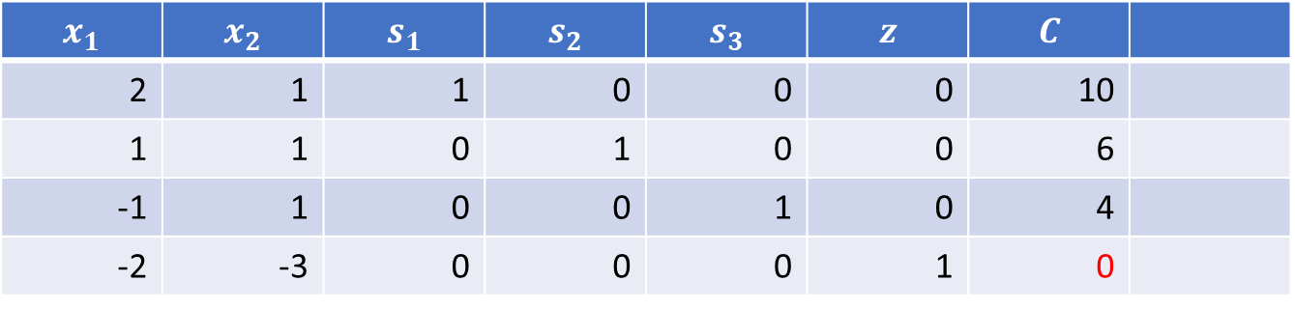
Reading a feasible solution
Any column with several nonzero coefficient, set variable to 0
Any column with a single 1, set variable to right-hand side
Read objective function value at bottom right
$$x_{1}$$ | $$x_{2}$$ | $$s_{1}$$ | $$s_{2}$$ | $$s_{3}$$ | $$z$$ | $$C$$
2 | 1 | 1 | 0 | 0 | 0 | 10
1 | 1 | 0 | 1 | 0 | 0 | 6
-1 | 1 | 0 | 0 | 1 | 0 | 4
-2 | -3 | 0 | 0 | 0 | 1 | 0
Feasible point: $x_{1}=0, x_{2}=0, s_{1}=10, s_{2}=6, s_{3}=4$, with objective $z=0$

Slide 11
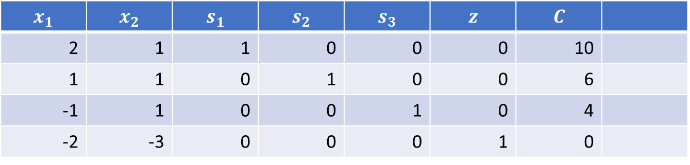
4.1 Find pivot
Pick a column with a negative number on the last row
Compute ratios and pick the lowest one
Identify the pivot
$$x_{1}$$ | $$x_{2}$$ | $$s_{1}$$ | $$s_{2}$$ | $$s_{3}$$ | $$z$$ | $$C$$
2 | 1 | 1 | 0 | 0 | 0 | 10
1 | 1 | 0 | 1 | 0 | 0 | 6
-1 | 1 | 0 | 0 | 1 | 0 | 4
-2 | -3 | 0 | 0 | 0 | 1 | 0

Slide 12
4.1 Find pivot
Pick a column with a negative number on the last row
Compute ratios and pick the lowest one
Identify the pivot
$$x_{1}$$ | $$x_{2}$$ | $$s_{1}$$ | $$s_{2}$$ | $$s_{3}$$ | $$z$$ | $$C$$
2 | 1 | 1 | 0 | 0 | 0 | 10
1 | 1 | 0 | 1 | 0 | 0 | 6
-1 | 1 | 0 | 0 | 1 | 0 | 4
-2 | -3 | 0 | 0 | 0 | 1 | 0

Slide 13
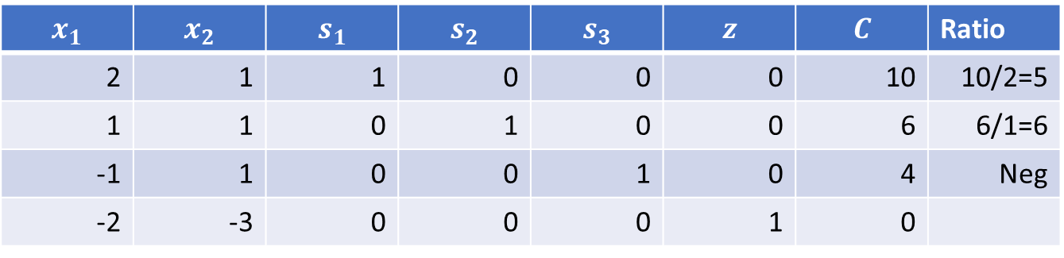
4.1 Find pivot
Pick a column with a negative number on the last row
Compute ratios and pick the lowest one
Identify the pivot
$$x_{1}$$ | $$x_{2}$$ | $$s_{1}$$ | $$s_{2}$$ | $$s_{3}$$ | $$z$$ | $$C$$ | Ratio
2 | 1 | 1 | 0 | 0 | 0 | 10 | 10/2=5
1 | 1 | 0 | 1 | 0 | 0 | 6 | 6/1=6
-1 | 1 | 0 | 0 | 1 | 0 | 4 | Neg
-2 | -3 | 0 | 0 | 0 | 1 | 0

Slide 14
4.1 Find pivot
Pick a column with a negative number on the last row
Compute ratios and pick the lowest one
Identify the pivot
$$x_{1}$$ | $$x_{2}$$ | $$s_{1}$$ | $$s_{2}$$ | $$s_{3}$$ | $$z$$ | $$C$$ | Ratio
2 | 1 | 1 | 0 | 0 | 0 | 10 | 10/2=5
1 | 1 | 0 | 1 | 0 | 0 | 6 | 6/1=6
-1 | 1 | 0 | 0 | 1 | 0 | 4 | Neg
-2 | -3 | 0 | 0 | 0 | 1 | 0

Slide 15
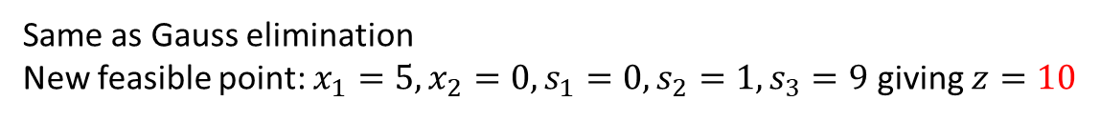
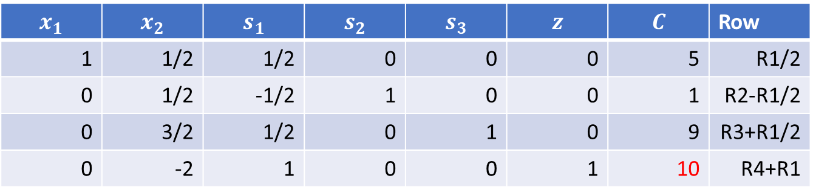
4.2 Pivot
Make pivot = 1
Make all other entries in that column equal to 0
$$x_{1}$$ | $$x_{2}$$ | $$s_{1}$$ | $$s_{2}$$ | $$s_{3}$$ | $$z$$ | $$C$$ | Row
1 | 1/2 | 1/2 | 0 | 0 | 0 | 5 | R1/2
0 | 1/2 | -1/2 | 1 | 0 | 0 | 1 | R2-R1/2
0 | 3/2 | 1/2 | 0 | 1 | 0 | 9 | R3+R1/2
0 | -2 | 1 | 0 | 0 | 1 | 10 | R4+R1
Same as Gauss elimination
New feasible point: $x_{1}=5, x_{2}=0, s_{1}=0, s_{2}=1, s_{3}=9$ giving $z=10$

Slide 16
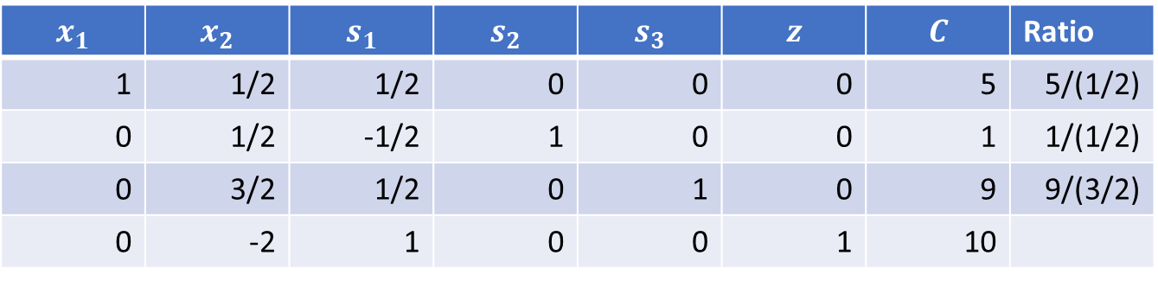
4.2 keep pivoting
Pick next pivot: column is negative entry on bottom row; row has lowest ratio
Pivot
$$x_{1}$$ | $$x_{2}$$ | $$s_{1}$$ | $$s_{2}$$ | $$s_{3}$$ | $$z$$ | $$C$$ | Ratio
1 | 1/2 | 1/2 | 0 | 0 | 0 | 5 | 5/(1/2)
0 | 1/2 | -1/2 | 1 | 0 | 0 | 1 | 1/(1/2)
0 | 3/2 | 1/2 | 0 | 1 | 0 | 9 | 9/(3/2)
0 | -2 | 1 | 0 | 0 | 1 | 10
10
2
6

Slide 17
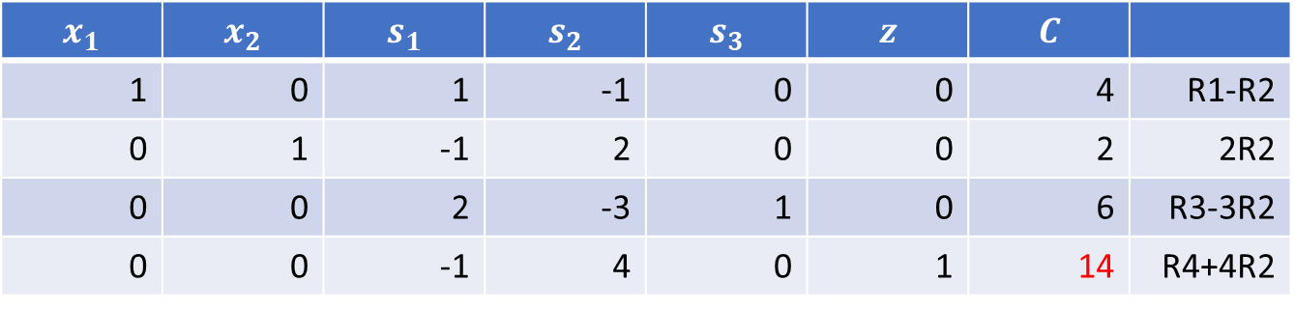
4.2 keep pivoting
Pick next pivot: column is negative entry on bottom row; row has lowest ratio
Pivot
$$x_{1}$$ | $$x_{2}$$ | $$s_{1}$$ | $$s_{2}$$ | $$s_{3}$$ | $$z$$ | $$C$$
1 | 0 | 1 | -1 | 0 | 0 | 4 | R1-R2
0 | 1 | -1 | 2 | 0 | 0 | 2 | 2R2
0 | 0 | 2 | -3 | 1 | 0 | 6 | R3-3R2
0 | 0 | -1 | 4 | 0 | 1 | 14 | R4+4R2
New feasible point: $x_{1}=4, x_{2}=2, s_{1}=0, s_{2}=0, s_{3}=6$ giving $z=14$

Slide 18
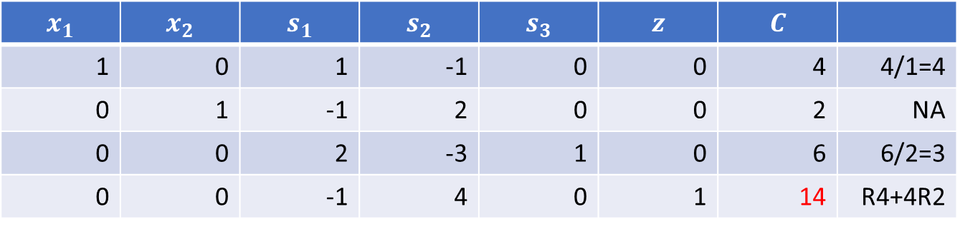
4.2 keep pivoting
Pick next pivot: column is negative entry on bottom row; row has lowest ratio. Discard any ratio that is negative, zero or denom=0
Pivot
$$x_{1}$$ | $$x_{2}$$ | $$s_{1}$$ | $$s_{2}$$ | $$s_{3}$$ | $$z$$ | $$C$$
1 | 0 | 1 | -1 | 0 | 0 | 4 | 4/1=4
0 | 1 | -1 | 2 | 0 | 0 | 2 | NA
0 | 0 | 2 | -3 | 1 | 0 | 6 | 6/2=3
0 | 0 | -1 | 4 | 0 | 1 | 14 | R4+4R2

Slide 19
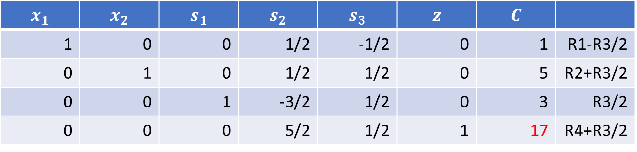
4.2 keep pivoting
Pick next pivot: column is negative entry on bottom row; row has lowest ratio. Discard any ratio that is negative, zero or denom=0
Pivot
$$x_{1}$$ | $$x_{2}$$ | $$s_{1}$$ | $$s_{2}$$ | $$s_{3}$$ | $$z$$ | $$C$$
1 | 0 | 0 | 1/2 | -1/2 | 0 | 1 | R1-R3/2
0 | 1 | 0 | 1/2 | 1/2 | 0 | 5 | R2+R3/2
0 | 0 | 1 | -3/2 | 1/2 | 0 | 3 | R3/2
0 | 0 | 0 | 5/2 | 1/2 | 1 | 17 | R4+R3/2
New feasible point: $x_{1}=1, x_{2}=5, s_{1}=3, s_{2}=0, s_{3}=0$ giving $z=17$

Slide 20

5 end when no negative entry in bottom row
Read optimal solution:
$x_{1}=1, x_{2}=5, s_{1}=3, s_{2}=0, s_{3}=0$ giving $z=17$
$$x_{1}$$ | $$x_{2}$$ | $$s_{1}$$ | $$s_{2}$$ | $$s_{3}$$ | $$z$$ | $$C$$
1 | 0 | 0 | 1/2 | -1/2 | 0 | 1 | R1-R3/2
0 | 1 | 0 | 1/2 | 1/2 | 0 | 5 | R2+R3/2
0 | 0 | 1 | -3/2 | 1/2 | 0 | 3 | R3/2
0 | 0 | 0 | 5/2 | 1/2 | 1 | 17 | R4+R3/2

Slide 21

Solving a linear program
$$\max{2x_{1}+3x_{2}} \\ 2x_{1}+x_{2}≤10 \\ x_{1}+x_{2}≤6 \\ −x_{1}+x_{2}≤4$$
has solution
$$x_{1}=1, x_{2}=5$$
with optimal value $2x_{1}+3x_{2}=17$

Slide 22
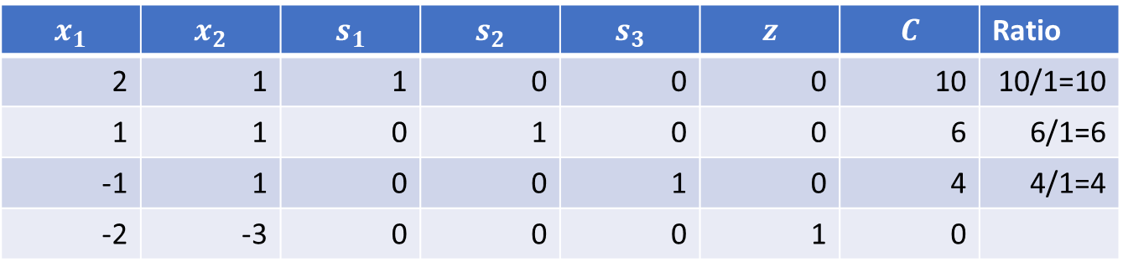
Going faster
Many variations for simplex to accelerate convergence
Simple one: pick the most negative number
$$x_{1}$$ | $$x_{2}$$ | $$s_{1}$$ | $$s_{2}$$ | $$s_{3}$$ | $$z$$ | $$C$$ | Ratio
2 | 1 | 1 | 0 | 0 | 0 | 10 | 10/1=10
1 | 1 | 0 | 1 | 0 | 0 | 6 | 6/1=6
-1 | 1 | 0 | 0 | 1 | 0 | 4 | 4/1=4
-2 | -3 | 0 | 0 | 0 | 1 | 0

Slide 23
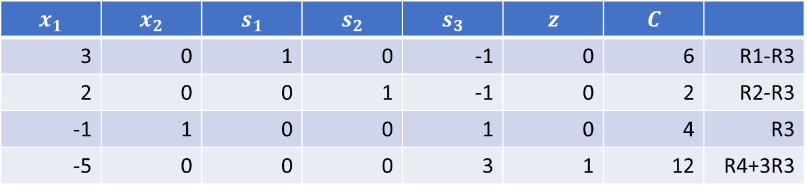
Going faster
Pivot
$$x_{1}$$ | $$x_{2}$$ | $$s_{1}$$ | $$s_{2}$$ | $$s_{3}$$ | $$z$$ | $$C$$
3 | 0 | 1 | 0 | -1 | 0 | 6 | R1-R3
2 | 0 | 0 | 1 | -1 | 0 | 2 | R2-R3
-1 | 1 | 0 | 0 | 1 | 0 | 4 | R3
-5 | 0 | 0 | 0 | 3 | 1 | 12 | R4+3R3
Feasible solution $x_{1}=0, x_{2}=4, s_{1}=6, s_{2}=2, s_{3}=0$ with $z=12$

Slide 24
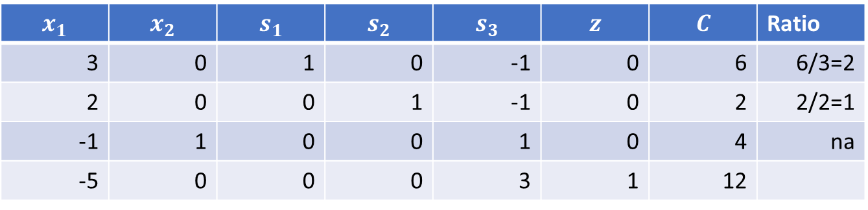
Going faster
Find next pivot
$$x_{1}$$ | $$x_{2}$$ | $$s_{1}$$ | $$s_{2}$$ | $$s_{3}$$ | $$z$$ | $$C$$ | Ratio
3 | 0 | 1 | 0 | -1 | 0 | 6 | 6/3=2
2 | 0 | 0 | 1 | -1 | 0 | 2 | 2/2=1
-1 | 1 | 0 | 0 | 1 | 0 | 4 | na
-5 | 0 | 0 | 0 | 3 | 1 | 12

Slide 25
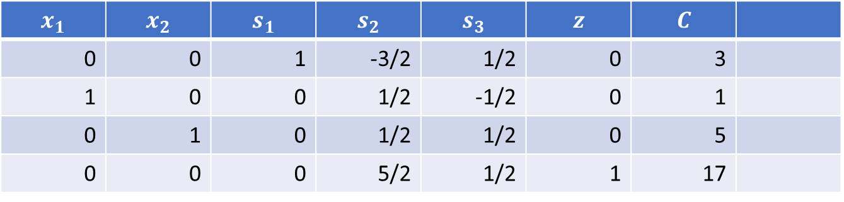
Going faster
Pivot
$$x_{1}$$ | $$x_{2}$$ | $$s_{1}$$ | $$s_{2}$$ | $$s_{3}$$ | $$z$$ | $$C$$
0 | 0 | 1 | -3/2 | 1/2 | 0 | 3
1 | 0 | 0 | 1/2 | -1/2 | 0 | 1
0 | 1 | 0 | 1/2 | 1/2 | 0 | 5
0 | 0 | 0 | 5/2 | 1/2 | 1 | 17

Slide 26
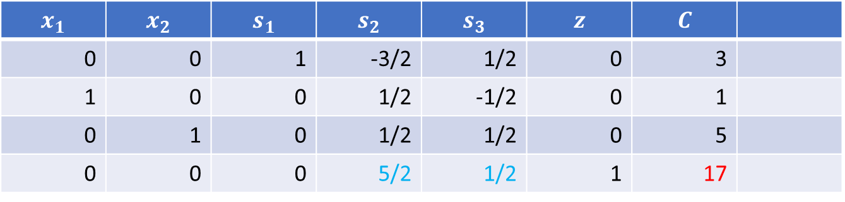

Going faster
No more negative value on bottom row
Read solution: $x_{1}=1, x_{2}=5$ with maximum $z=17$
Note that the coefficients $\frac{5}{2},\frac{1}{2}$ were the one used to prove solution
$$x_{1}$$ | $$x_{2}$$ | $$s_{1}$$ | $$s_{2}$$ | $$s_{3}$$ | $$z$$ | $$C$$
0 | 0 | 1 | -3/2 | 1/2 | 0 | 3
1 | 0 | 0 | 1/2 | -1/2 | 0 | 1
0 | 1 | 0 | 1/2 | 1/2 | 0 | 5
0 | 0 | 0 | 5/2 | 1/2 | 1 | 17

Slide 27
Congratulation!
You’ve just ran successfully the famous Simplex Method
This is one of the top 10 algorithms of the 20th century!! See https://archive.siam.org/news/news.php?id=637

Slide 28
The general (primal) problem

Slide 29
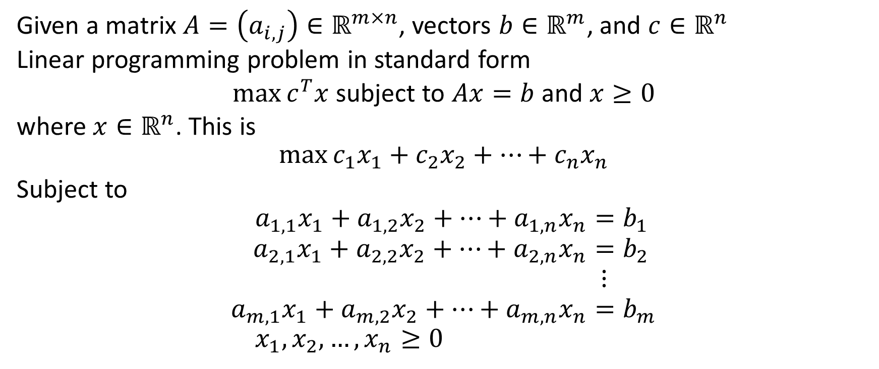
Primal problem in standard form
Given a matrix $A=\left(a_{i,j}\right)∈ℝ^{m×n}$, vectors $b∈ℝ^{m}$, and $c∈ℝ^{n}$
Linear programming problem in standard form
$\max{c^{T}x}$ subject to $Ax=b$ and $x≥0$
where $x∈ℝ^{n}$. This is
$$\max{c_{1}x_{1}+c_{2}x_{2}+…+c_{n}x_{n}}$$
Subject to
$$a_{1,1}x_{1}+a_{1,2}x_{2}+…+a_{1,n}x_{n}=b_{1} \\ a_{2,1}x_{1}+a_{2,2}x_{2}+…+a_{2,n}x_{n}=b_{2} \\ ⋮ \\ a_{m,1}x_{1}+a_{m,2}x_{2}+…+a_{m,n}x_{n}=b_{m} \\ x_{1},x_{2},…,x_{n}≥0$$

Slide 30
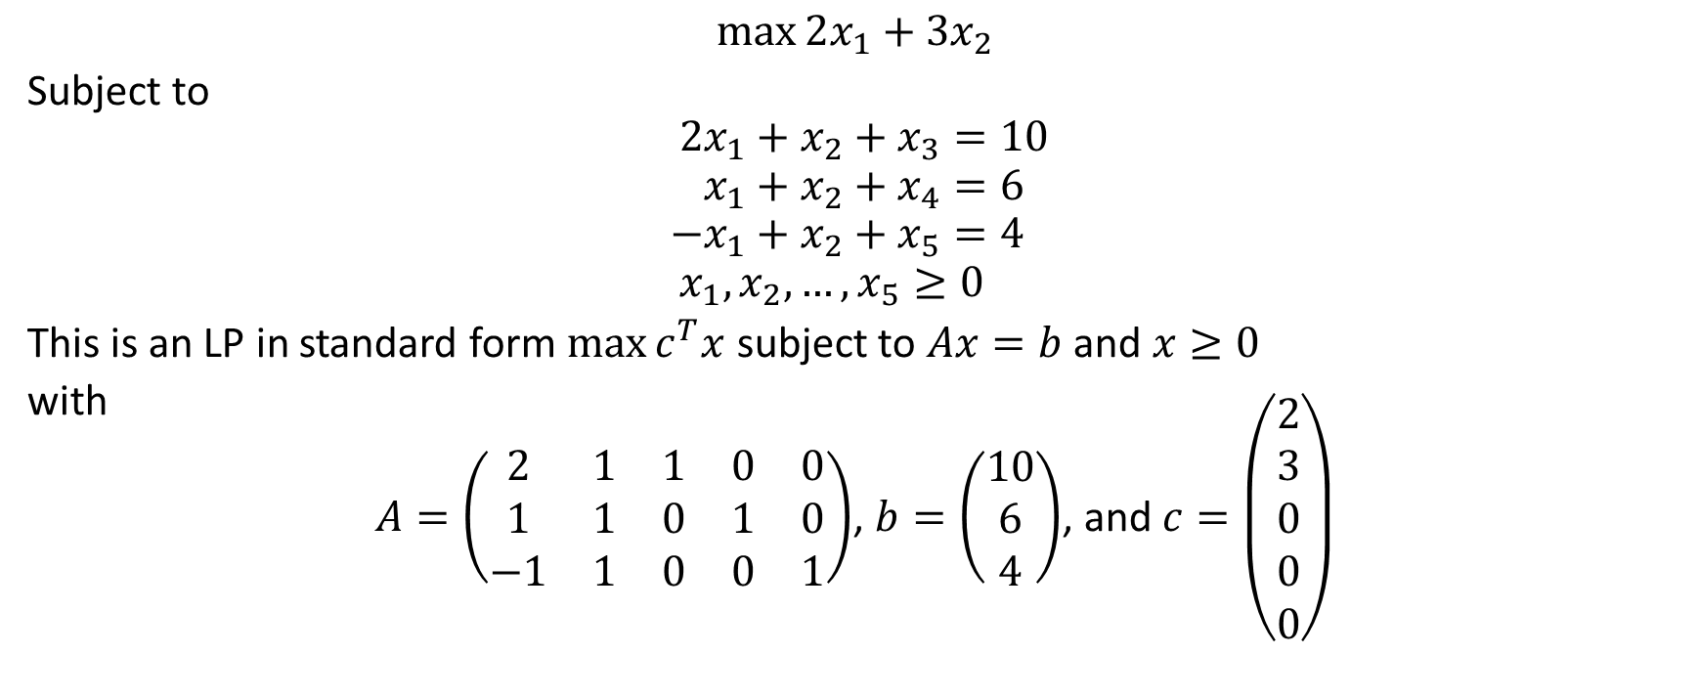
Orange problem
$$\max{2x_{1}+3x_{2}}$$
Subject to
$$2x_{1}+x_{2}+x_{3}=10 \\ x_{1}+x_{2}+x_{4}=6 \\ −x_{1}+x_{2}+x_{5}=4 \\ x_{1},x_{2},…,x_{5}≥0$$
This is an LP in standard form $\max{c^{T}x}$ subject to $Ax=b$ and $x≥0$
with
$A=\left(\begin{matrix}2 & 1 & 1 & 0 & 0 \\ 1 & 1 & 0 & 1 & 0 \\ −1 & 1 & 0 & 0 & 1\end{matrix}\right)$, $b=\left(\begin{matrix}10 \\ 6 \\ 4\end{matrix}\right)$, and $c=\left(\begin{matrix}2 \\ 3 \\ 0 \\ 0 \\ 0\end{matrix}\right)$

Slide 31

Initial tableau
$$\left[\begin{matrix}A & 0 & b \\ −c^{T} & 1 & 0\end{matrix}\right]$$
Block matrix:
$A$ is $n×n$
$0$ is $n×1$
$b$ is $n×1$
$−c^{T}$ is $1×n$
$1$ is $1×1$
$0$ is $1×1$

Slide 32
Simplex method
Write the LP in standard form; introduce slack variables as needed
Set up initial simplex tableau
While there is a negative coefficient in bottom row
Find a pivot
Pivot
Read the optimal solution

Slide 33
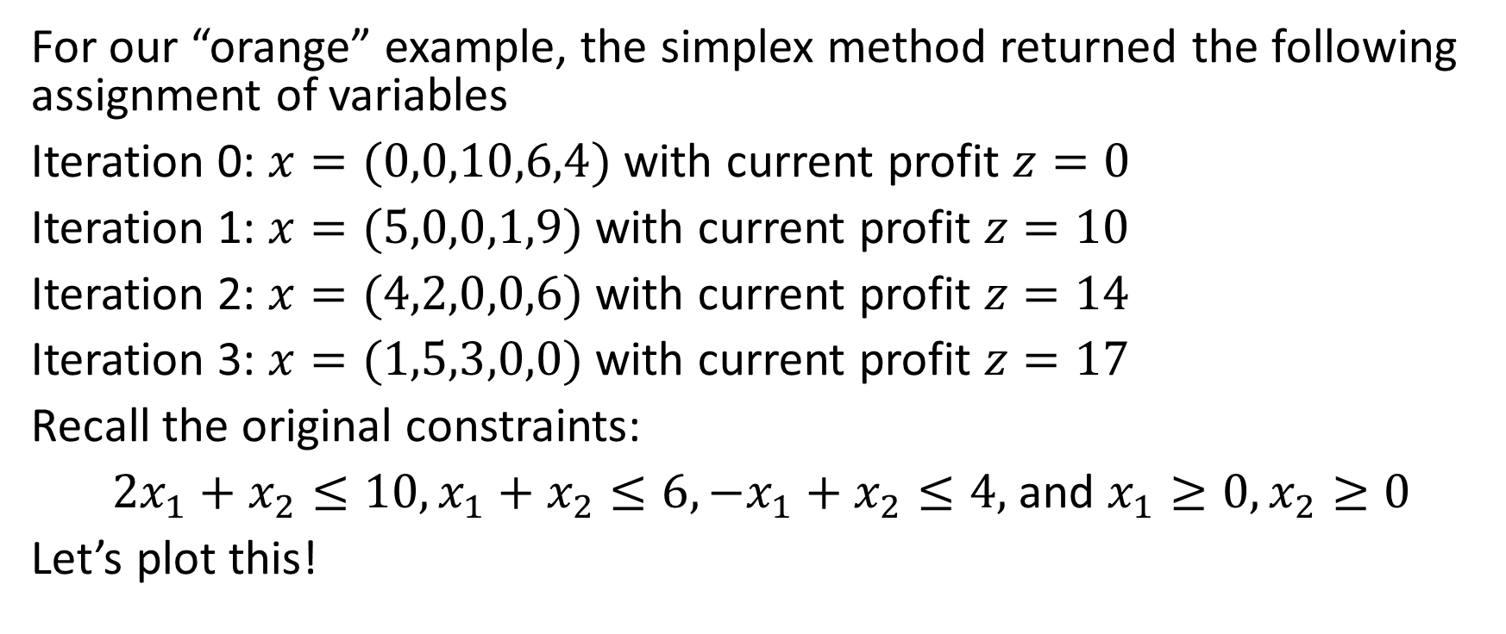
Example
For our “orange” example, the simplex method returned the following assignment of variables
Iteration 0: $x=(0,0,10,6,4)$ with current profit $z=0$
Iteration 1: $x=(5,0,0,1,9)$ with current profit $z=10$
Iteration 2: $x=(4,2,0,0,6)$ with current profit $z=14$
Iteration 3: $x=(1,5,3,0,0)$ with current profit $z=17$
Recall the original constraints:
$2x_{1}+x_{2}≤10, x_{1}+x_{2}≤6, −x_{1}+x_{2}≤4,$ and $x_{1}≥0, x_{2}≥0$
Let’s plot this!

Slide 34
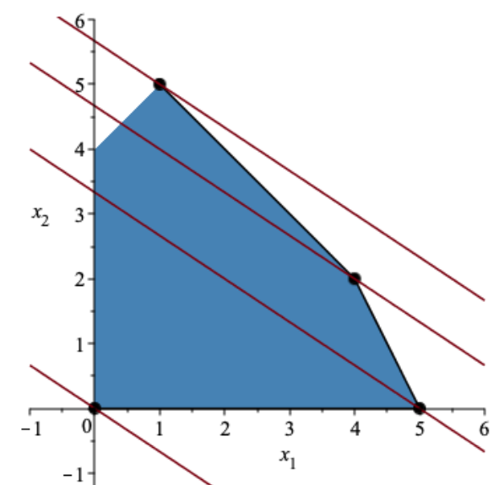
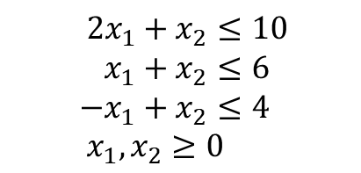
Plot with Maple
Method 1: pick pivot in order
(0,0) cost 0
(5,0) cost 10
(4,2) cost 14
(1,5) cost 17
$$2x_{1}+x_{2}≤10 \\ x_{1}+x_{2}≤6 \\ −x_{1}+x_{2}≤4 \\ x_{1},x_{2}≥0$$
Method 2: pick most negative
(0,0) cost 0
(0,4) cost 12
(1,5) cost 17
Feasible region and “profit lines” $z=2x_{1}+3x_{2}$ for $z∈\{0,10,14,17\}$

Slide 35
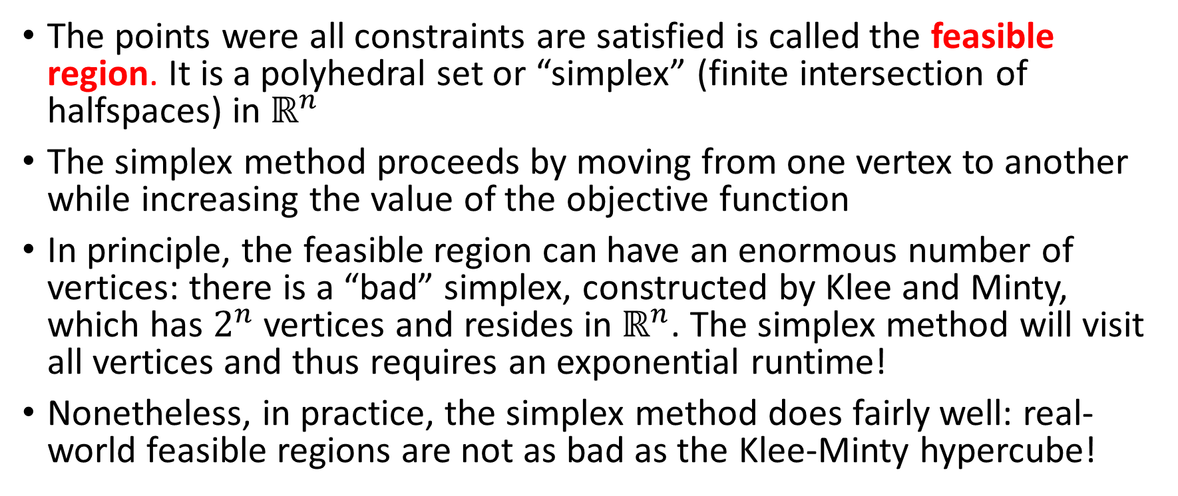
Simplex Method (cont)
The points were all constraints are satisfied is called the feasible region. It is a polyhedral set or “simplex” (finite intersection of halfspaces) in $ℝ^{n}$
The simplex method proceeds by moving from one vertex to another while increasing the value of the objective function
In principle, the feasible region can have an enormous number of vertices: there is a “bad” simplex, constructed by Klee and Minty, which has $2^{n}$ vertices and resides in $ℝ^{n}$. The simplex method will visit all vertices and thus requires an exponential runtime!
Nonetheless, in practice, the simplex method does fairly well: real-world feasible regions are not as bad as the Klee-Minty hypercube!

Slide 36
Duality

Slide 37
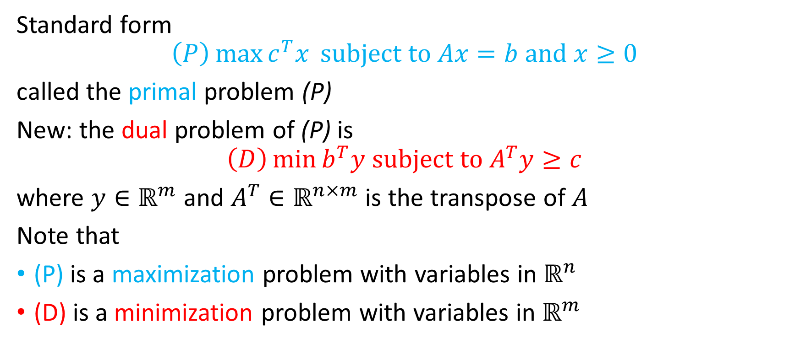
The primal and dual problem
Standard form
$$\left(P\right)\max{c^{T}x }subject to Ax=b and x≥0$$
called the primal problem (P)
New: the dual problem of (P) is
$$\left(D\right)\min{b^{T}y subject to A^{T}y≥c}$$
where $y∈ℝ^{m}$ and $A^{T}∈ℝ^{n×m}$ is the transpose of $A$
Note that
(P) is a maximization problem with variables in $ℝ^{n}$
(D) is a minimization problem with variables in $ℝ^{m}$

Slide 38

“Orange” primal (P) and dual (D)
(P) $\max{2x_{1}+3x_{2}}$
Subject to
$$2x_{1}+x_{2}+x_{3}=10 \\ x_{1}+x_{2}+x_{4}=6 \\ −x_{1}+x_{2}+x_{5}=4 \\ x_{1},x_{2},…,x_{5}≥0$$
has dual
(D) $\min{10y_{1}+6y_{2}+4y_{3}}$
Subject to
$$2y_{1}+y_{2}−y_{3}≥2 \\ y_{1}+y_{2}+y_{3}≥3 \\ y_{1},y_{2},y_{3}≥0$$

Slide 39
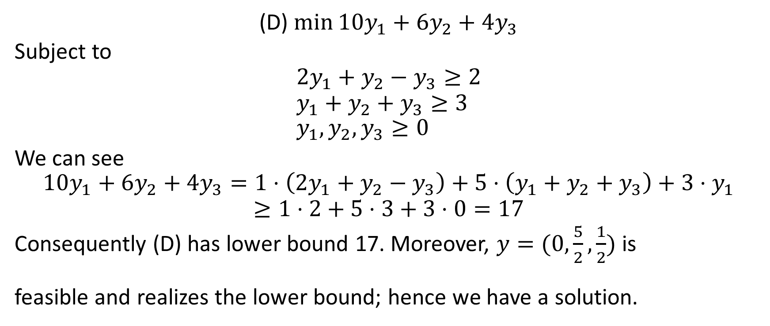
Solving the dual
(D) $\min{10y_{1}+6y_{2}+4y_{3}}$
Subject to
$$2y_{1}+y_{2}−y_{3}≥2 \\ y_{1}+y_{2}+y_{3}≥3 \\ y_{1},y_{2},y_{3}≥0$$
We can see
$$10y_{1}+6y_{2}+4y_{3}=1⋅\left(2y_{1}+y_{2}−y_{3}\right)+5⋅\left(y_{1}+y_{2}+y_{3}\right)+3⋅y_{1} \\ ≥1⋅2+5⋅3+3⋅0=17$$
Consequently (D) has lower bound 17. Moreover, $y=(0,\frac{5}{2},\frac{1}{2})$ is
feasible and realizes the lower bound; hence we have a solution.

Slide 40
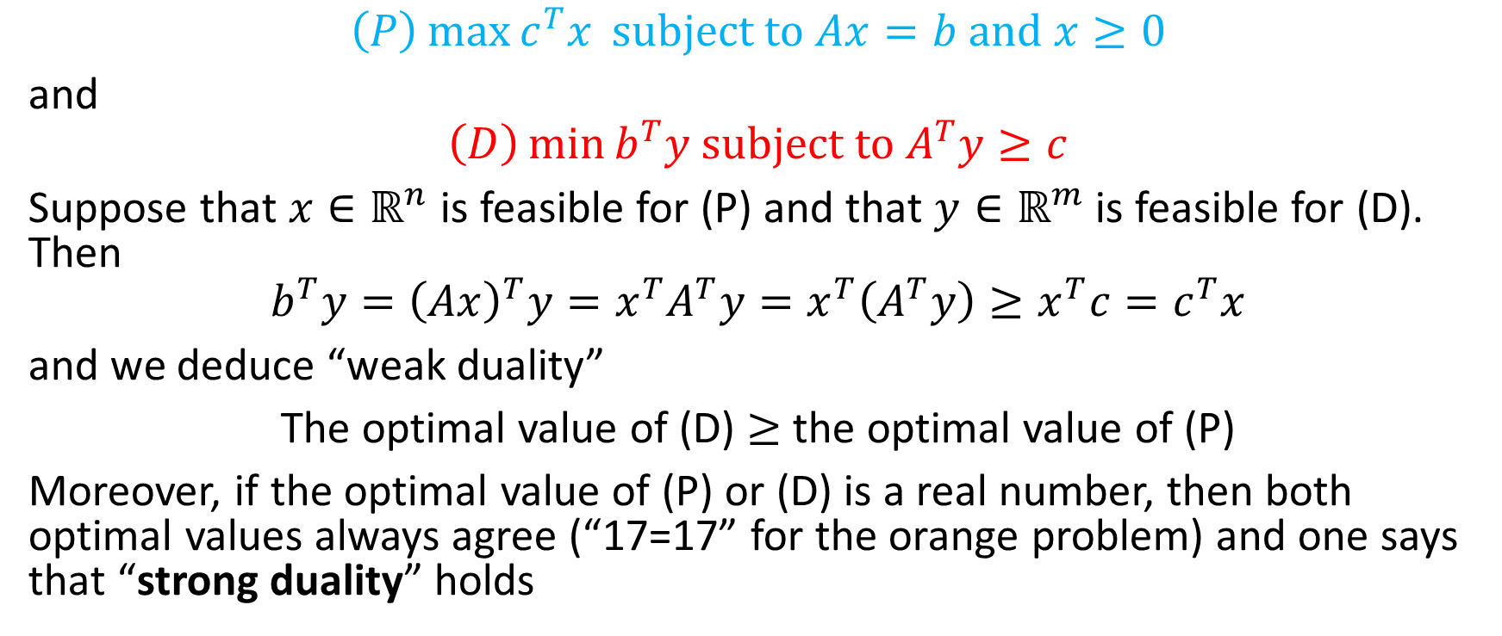
Weak duality
$$\left(P\right)\max{c^{T}x }subject to Ax=b and x≥0$$
and
$$\left(D\right)\min{b^{T}y subject to A^{T}y≥c}$$
Suppose that $x∈ℝ^{n}$ is feasible for (P) and that $y∈ℝ^{m}$ is feasible for (D). Then
$$b^{T}y={\left(Ax\right)}^{T}y=x^{T}A^{T}y=x^{T}\left(A^{T}y\right)≥x^{T}c=c^{T}x$$
and we deduce “weak duality”
The optimal value of (D) $≥$ the optimal value of (P)
Moreover, if the optimal value of (P) or (D) is a real number, then both optimal values always agree (“17=17” for the orange problem) and one says that “strong duality” holds

Slide 41
References
Simplex method tutorials
https://personal.utdallas.edu/~scniu/OPRE-6201/documents/LP06-Simplex-Tableau.pdf
https://vijayasriiyer.medium.com/simplex-method-the-easy-way-f19e61095ac7
https://math.libretexts.org/Bookshelves/Applied_Mathematics/Applied_Finite_Mathematics_(Sekhon_and_Bloom)/04%3A_Linear_Programming_The_Simplex_Method/4.02%3A_Maximization_By_The_Simplex_Method
Linear optimization solver online https://online-optimizer.appspot.com/?model=builtin:default.mod
George B. Dantzig and Mukund N. Thapa:Linear Programming I, II
Thomas S. Ferguson: Linear Programming, https://www.math.ucla.edu/~tom/LP.pdf
B. Guenin, J. Könemann, and L. Tunçel: A Gentle Introduction to Optimization
Frederick S. Hillier, and Gerald J. Lieberman: Introduction to Operations Research
Wayne L. Winston: Operations Research
Wikipedia

